Slide 1
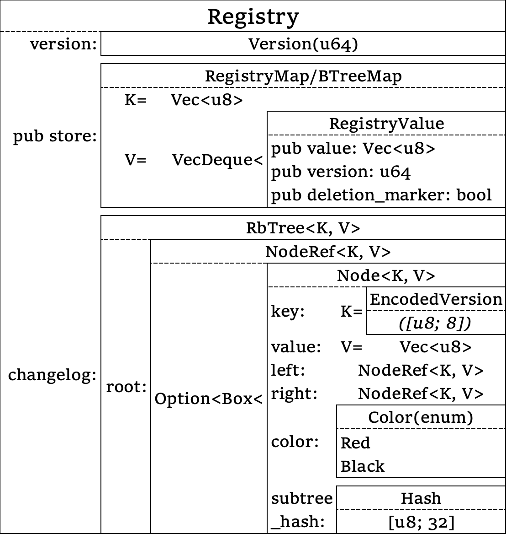
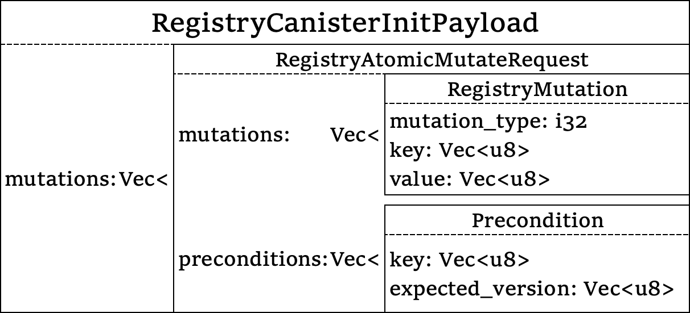
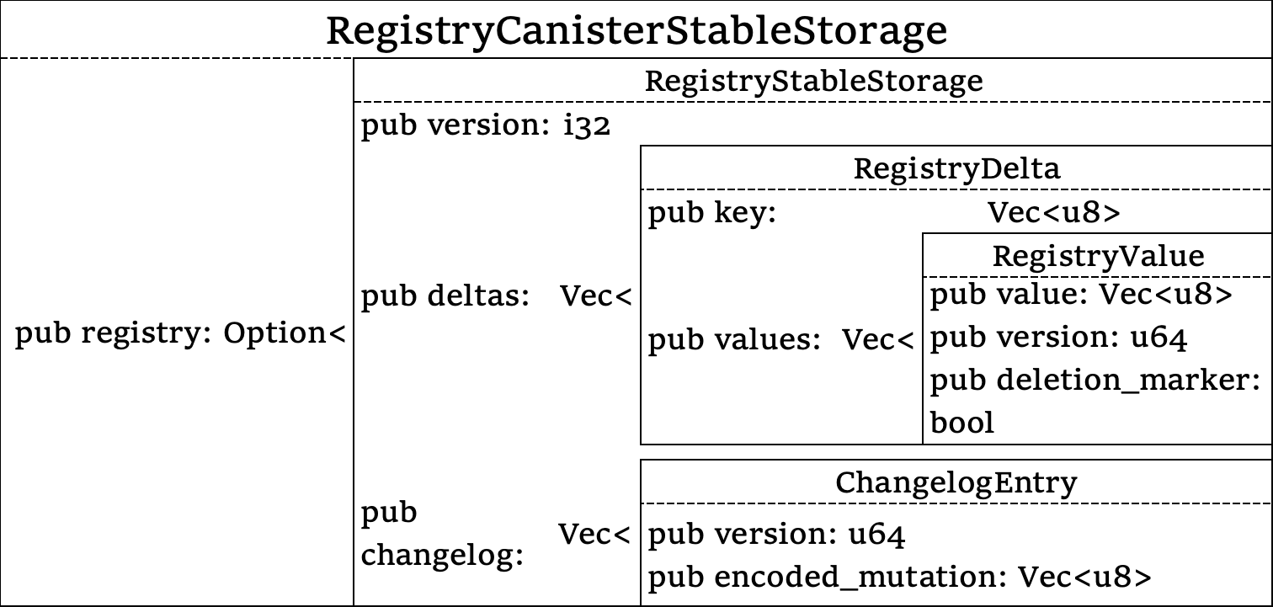
V = Vec<u8> = RegistryAtomicMutateRequest::encode()
encoded_mutation = V = RegistryAtomicMutateRequest::encode()

